Slide 1

HR Analytical Dashboard
Comprehensive HR Data Analysis
Piyush Goel STU64f4aeabe97e31693757099

Slide 2

PROBLEM STATEMENT
The organization is grappling with high employee attrition rates, which negatively impact productivity and increase recruitment costs. There is a lack of comprehensive insight into the demographic factors influencing employee retention and attrition, making it difficult to develop effective HR strategies. Additionally, current HR practices are not fully data-driven, leading to suboptimal decision-making regarding employee management and retention. To address these challenges, the organization needs detailed, actionable insights to optimize HR policies, enhance employee satisfaction, and reduce attrition rates.

Slide 3
Project Description
Developed a comprehensive HR Analytical Dashboard using Power BI.
Analyzed employee data across various departments and roles.
Visualized key metrics like attrition rates, average salary, age distribution, and job roles.
Provided actionable insights to optimize HR strategies and improve employee retention.

Slide 4

WHO ARE THE END USERS?
HR Managers:
Role: Oversee employee relations, benefits, recruitment, and compliance.
Usage: Use the dashboard to monitor attrition rates, identify trends in employee satisfaction, and develop strategies to reduce turnover. Track the effectiveness of HR policies and programs.
Senior Management:
Role: Make high-level strategic decisions impacting the overall direction of the company.
Usage: Utilize the dashboard to gain insights into workforce demographics, performance metrics, and employee retention. Inform long-term planning and resource allocation decisions.
Recruitment Teams:
Role: Manage the hiring process, from sourcing candidates to onboarding new employees.
Usage: Leverage the dashboard to identify areas with high attrition and strategize targeted recruitment efforts. Analyze trends in hiring and turnover to improve recruitment practices and candidate selection.
Department Heads:
Role: Manage specific departments, ensuring their teams are effective and productive.
Usage: Use the dashboard to understand attrition within their departments, assess employee satisfaction, and address potential issues proactively. Align department goals with overall company objectives based on data insights.

Slide 5
Technology Used
Power BI:
Description: Business analytics tool for interactive visualizations and reports.
Usage: Created dashboards to visualize HR metrics like attrition rates, salaries, and demographics.
Excel:
Description: Spreadsheet program for data analysis.
Usage: Preprocessed and organized raw data for analysis.
SQL:
Description: Language for managing databases.
Usage: Queried and extracted relevant employee data for analysis.

Slide 6
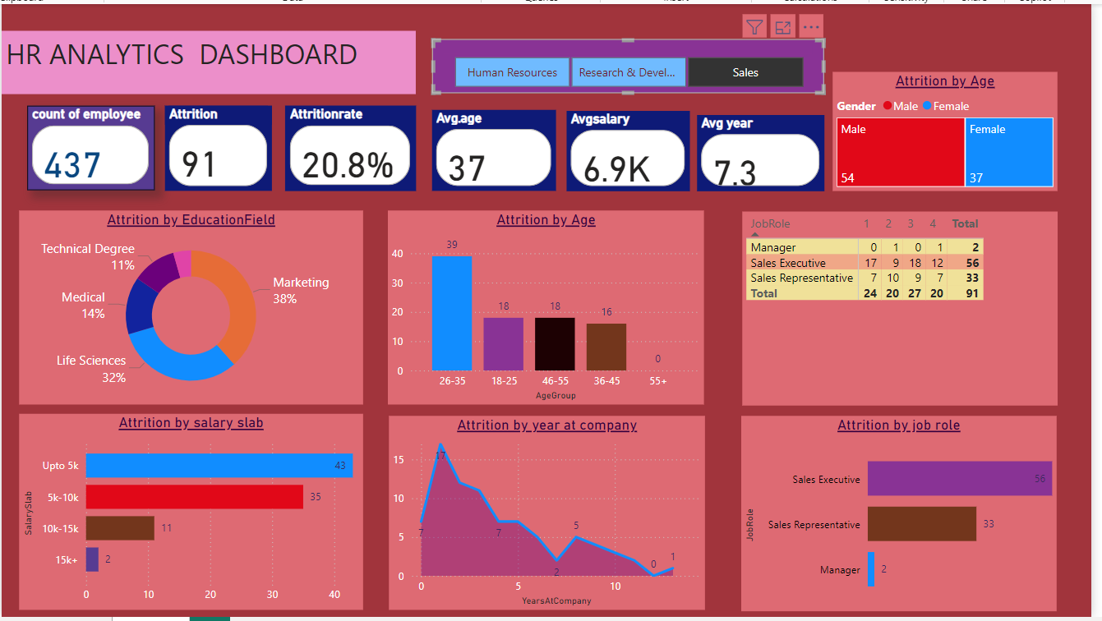
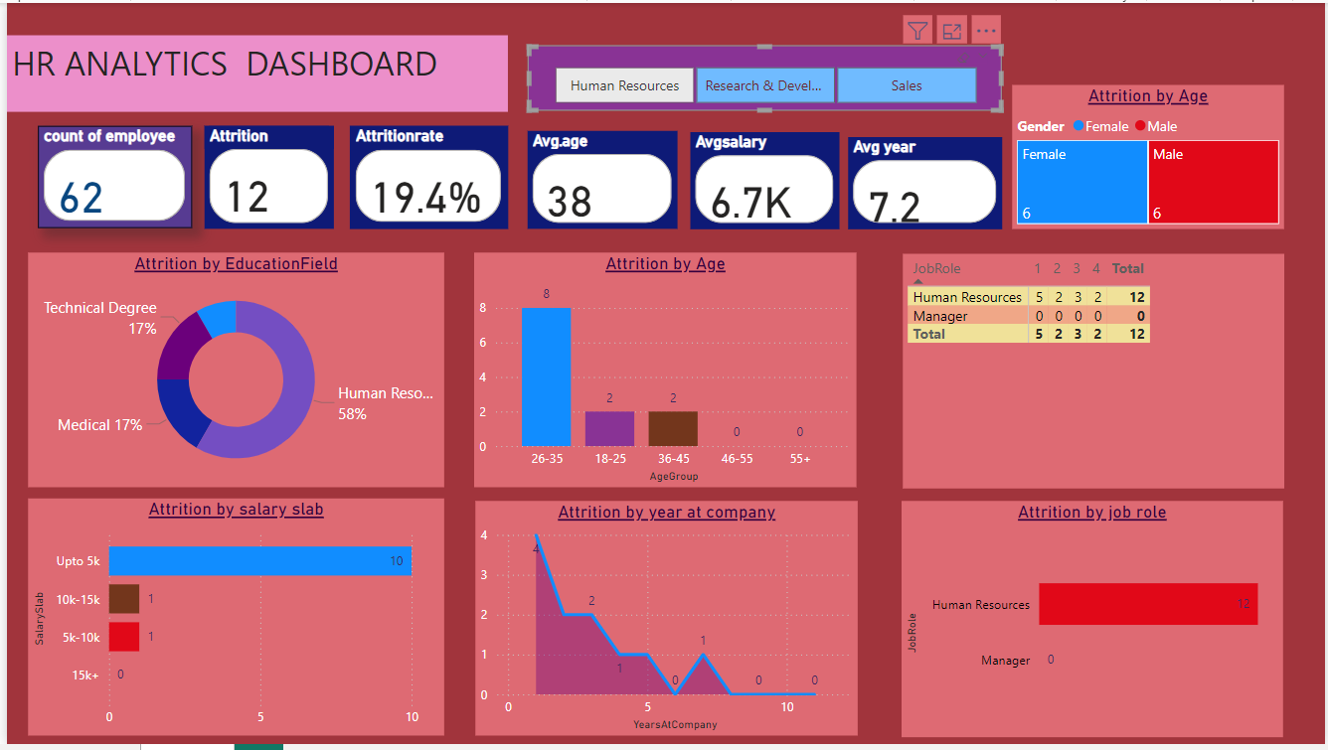
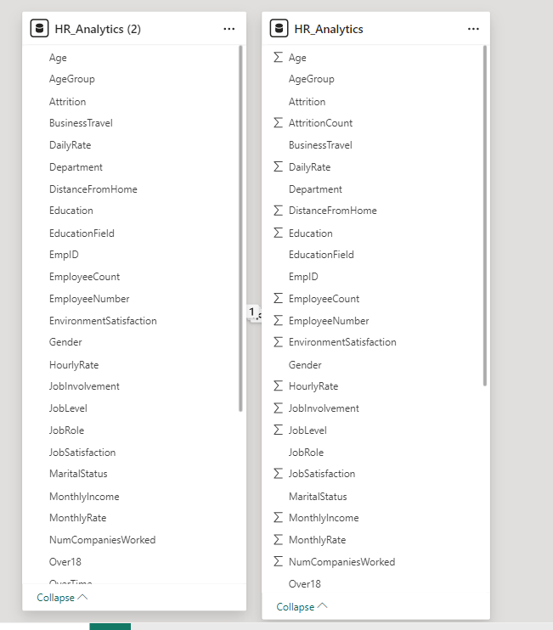
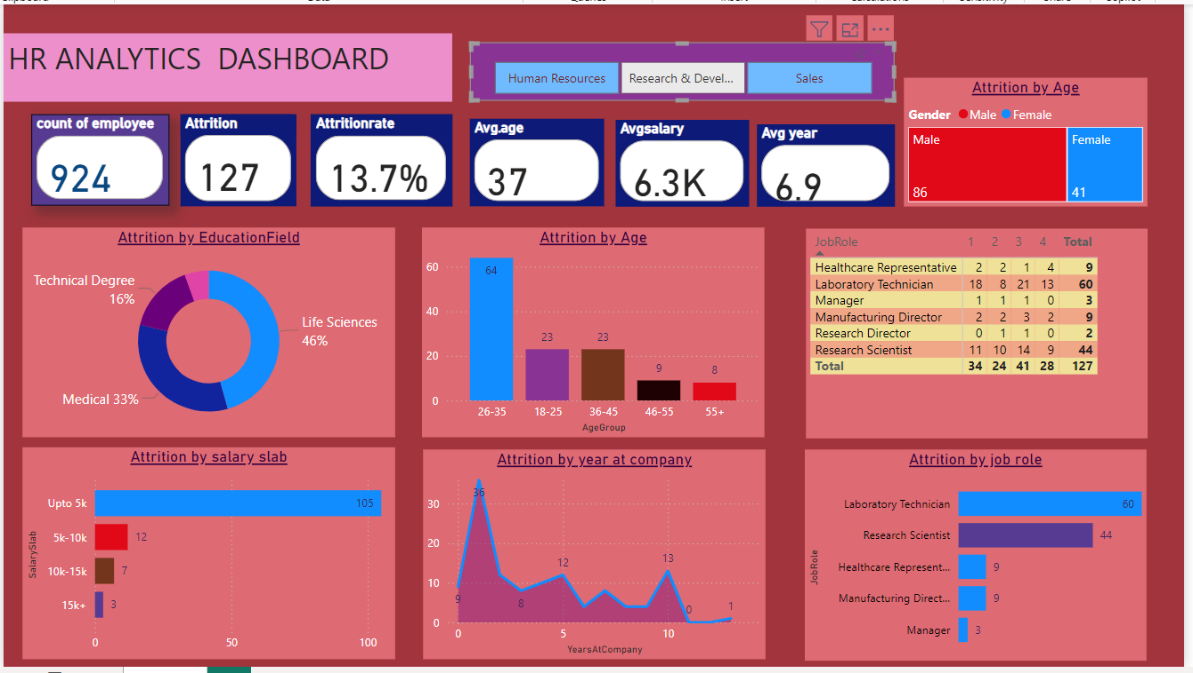
RESULTS
Model View
Demo Link

Slide 7
Thank you
Piyush Goel STU64f4aeabe97e31693757099 Drive Link:- Link Github Link:- Link
.
.

